Slide 1
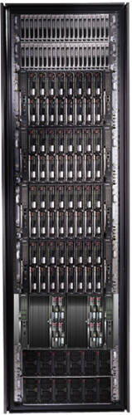
Cluster Computing with DryadLINQ
Mihai Budiu
Microsoft Research, Silicon Valley
Cloudera, February 12, 2010

Slide 2

Goal
Notes:
Enable any programmer to write and run applications on small and large computer clusters.

Slide 3
Design Space
Grid
Internet
Data-
parallel
Search
Dryad
Shared
memory
Private
data
center
Transaction
HPC
Latency
Throughput
Notes:
Dryad is optimized for: throughput, data-parallel computation, in a private data-center.

Slide 4
Data-Parallel Computation
Application
SQL
Sawzall
≈SQL
LINQ, SQL
Parallel Databases
Sawzall
Pig, Hive
DryadLINQ Scope
Language
Map-Reduce
Hadoop
Dryad
Execution
Cosmos, HPC, Azure
GFS BigTable
HDFS
S3
Cosmos
Azure SQL Server
Storage

Slide 5
Software Stack
Applications
Analytics
Machine Learning
Data mining
Optimi-
zation
SQL
C#
Graphs
legacy code
SSIS
PSQL
Scope
.Net
Distributed Data Structures
SQL server
Distributed Shell
DryadLINQ
C++
Dryad
Cosmos FS
Azure XStore
SQL Server
Tidy FS
NTFS
Cosmos
Azure XCompute
Windows HPC
Windows Server
Windows Server
Windows Server
Windows Server

Slide 6
Outline
Introduction
Dryad
DryadLINQ
Building on DryadLINQ
Conclusions

Slide 7
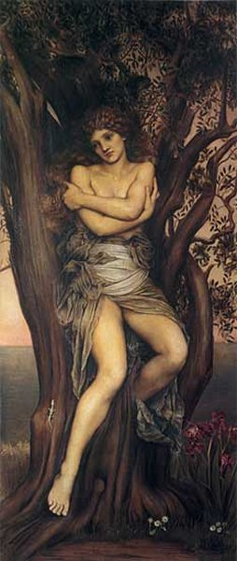
Dryad
Continuously deployed since 2006
Running on >> 10⁴ machines
Sifting through > 10Pb data daily
Runs on clusters > 3000 machines
Handles jobs with > 10⁵ processes each
Platform for rich software ecosystem
Used by >> 100 developers
Written at Microsoft Research, Silicon Valley

Slide 8
Dryad = Execution Layer
Job (application)
Pipeline
≈
Dryad
Shell
Cluster
Machine
Notes:
In the same way as the Unix shell does not understand the pipeline running on top, but manages its execution (i.e., killing processes when one exits), Dryad does not understand the job running on top.

Slide 9

2-D Piping
Unix Pipes: 1-D
grep | sed | sort | awk | perl
Dryad: 2-D
grep¹⁰⁰⁰ | sed⁵⁰⁰ | sort¹⁰⁰⁰ | awk⁵⁰⁰ | perl⁵⁰
Notes:
Dryad is a generalization of the Unix piping mechanism: instead of uni-dimensional (chain) pipelines, it provides two-dimensional pipelines. The unit is still a process connected by a point-to-point channel, but the processes are replicated.

Slide 10
Virtualized 2-D Pipelines
Notes:
This is a possible schedule of a Dryad job using 2 machines.

Slide 11


Virtualized 2-D Pipelines

Slide 12

Virtualized 2-D Pipelines

Slide 13
Virtualized 2-D Pipelines

Slide 14
Virtualized 2-D Pipelines
2D DAG
multi-machine
virtualized
Notes:
The Unix pipeline is generalized 3-ways:
2D instead of 1D
spans multiple machines
resources are virtualized: you can run the same large job on many or few machines

Slide 15
Dryad Job Structure
Channels
Input files
Stage
Output files
grep
sort
awk
sed
perl
grep
sort
sed
awk
grep
sort
Vertices (processes)
Notes:
This is the basic Dryad terminology.

Slide 16
Channels
Finite streams of items
distributed filesystem files (persistent)
SMB/NTFS files (temporary)
TCP pipes (inter-machine)
memory FIFOs (intra-machine)
X
Items
M
Notes:
Channels are very abstract, enabling a variety of transport mechanisms.
The performance and fault-tolerance of these machanisms vary widely.

Slide 17
Dryad System Architecture
data plane
Files, TCP, FIFO, Network
job schedule
V
V
V
NS, Sched
PD
PD
PD
control plane
Job manager
cluster
Notes:
The brain of a Dryad job is a centralized Job Manager, which maintains a complete state of the job.
The JM controls the processes running on a cluster, but never exchanges data with them.
(The data plane is completely separated from the control plane.)

Slide 18



Fault Tolerance
Notes:
Vertex failures and channel failures are handled differently.

Slide 19
Policy Managers
R
R
R
R
Stage R
Connection R-X
X
X
X
X
Stage X
X Manager
R manager
R-X Manager
Job
Manager

Slide 20
Dynamic Graph Rewriting
X[0]
X[1]
X[3]
X[2]
X’[2]
Slow vertex
Duplicate vertex
Completed vertices
Duplication Policy = f(running times, data volumes)
Notes:
The handling of apparently very slow computation by duplication of vertices is handled by a stage manager.

Slide 21
Cluster network topology
top-level switch
top-of-rack switch
rack

Slide 22
Dynamic Aggregation
S
S
S
S
S
S
T
static
S
S
S
S
S
S
# 1
# 2
# 1
# 3
# 3
# 2
rack #
A
A
A
# 1
# 2
# 3
dynamic
T
Notes:
Aggregating data with associative operators can be done in a bandwidth-preserving fashion in the intermediate aggregations are placed close to the source data.

Slide 23

Policy vs. Mechanism
Application-level
Most complex in C++ code
Invoked with upcalls
Need good default implementations
DryadLINQ provides a comprehensive set
Built-in
Scheduling
Graph rewriting
Fault tolerance
Statistics and reporting

Slide 24
Outline
Introduction
Dryad
DryadLINQ
Building on DryadLINQ
Conclusions

Slide 25

LINQ
=> DryadLINQ
Dryad
Notes:
DryadLINQ adds a wealth of features on top of plain Dryad.

Slide 26
LINQ = .Net+ Queries
Collection<T> collection;
bool IsLegal(Key);
string Hash(Key);
var results = from c in collection where IsLegal(c.key) select new { Hash(c.key), c.value};
Notes:
Language Integrated Query is an extension of .Net which allows one to write declarative computations on collections (green part).

Slide 27

Collections and Iterators
class Collection<T> : IEnumerable<T>;
public interface IEnumerable<T> {
IEnumerator<T> GetEnumerator();
}
public interface IEnumerator <T> {
T Current { get; }
bool MoveNext();
void Reset();
}

Slide 28

DryadLINQ Data Model
.Net objects
Partition
Collection

Slide 29

DryadLINQ = LINQ + Dryad
Collection<T> collection;
bool IsLegal(Key k);
string Hash(Key);
var results = from c in collection where IsLegal(c.key) select new { Hash(c.key), c.value};
Vertex code
Query plan
(Dryad job)
Data
collection
C#
C#
C#
C#
results
Notes:
DryadLINQ translates LINQ programs into Dryad computations:
- C# and LINQ data objects become distributed partitioned files.
- LINQ queries become distributed Dryad jobs.
- C# methods become code running on the vertices of a Dryad job.

Slide 30
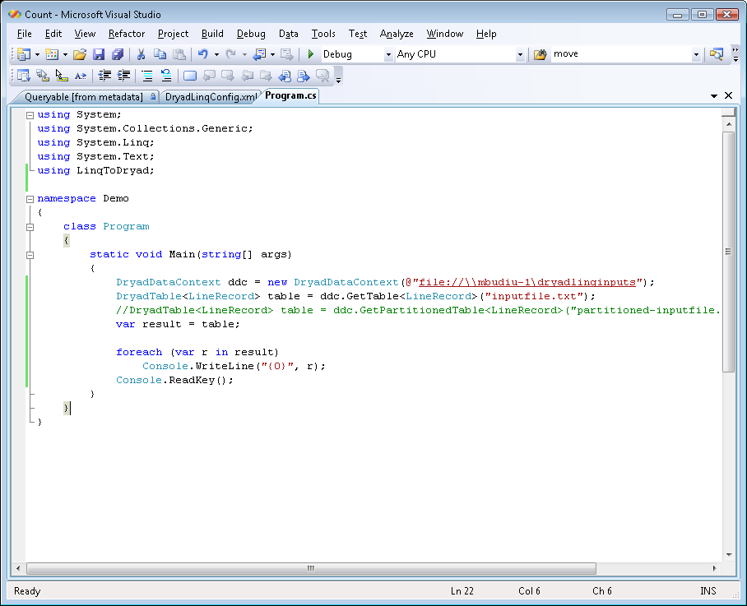
Demo

Slide 31
Example: Histogram
public static IQueryable<Pair> Histogram(
IQueryable<LineRecord> input, int k)
{
var words = input.SelectMany(x => x.line.Split(' '));
var groups = words.GroupBy(x => x);
var counts = groups.Select(x => new Pair(x.Key, x.Count()));
var ordered = counts.OrderByDescending(x => x.count);
var top = ordered.Take(k);
return top;
}
“A line of words of wisdom”
[“A”, “line”, “of”, “words”, “of”, “wisdom”]
[[“A”], [“line”], [“of”, “of”], [“words”], [“wisdom”]]
[ {“A”, 1}, {“line”, 1}, {“of”, 2}, {“words”, 1}, {“wisdom”, 1}]
[{“of”, 2}, {“A”, 1}, {“line”, 1}, {“words”, 1}, {“wisdom”, 1}]
[{“of”, 2}, {“A”, 1}, {“line”, 1}]

Slide 32
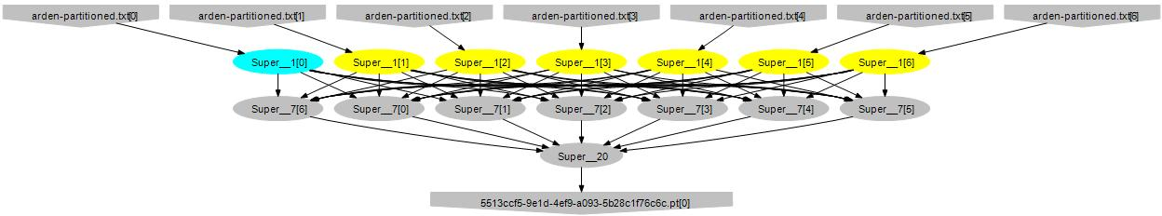
Histogram Plan
SelectMany
Sort
GroupBy+Select
HashDistribute
MergeSort
GroupBy
Select
Sort
Take
MergeSort
Take

Slide 33
Map-Reduce in DryadLINQ
public static IQueryable<S> MapReduce<T,M,K,S>(
this IQueryable<T> input,
Func<T, IEnumerable<M>> mapper,
Func<M,K> keySelector,
Func<IGrouping<K,M>,S> reducer)
{
var map = input.SelectMany(mapper);
var group = map.GroupBy(keySelector);
var result = group.Select(reducer);
return result;
}

Slide 34
Map-Reduce Plan
M
M
M
M
M
M
M
map
Q
Q
Q
Q
Q
Q
Q
sort
G₁
G₁
G₁
G₁
G₁
G₁
G₁
groupby
map
M
R
R
R
R
R
R
R
reduce
D
D
D
D
D
D
D
distribute
G
R
MS
MS
MS
MS
MS
mergesort
groupby
X
G₂
G₂
G₂
G₂
G₂
partial aggregation
R
R
R
R
R
reduce
X
X
X
MS
MS
mergesort
static
dynamic
dynamic
G₂
G₂
groupby
reduce
S
S
S
S
S
S
R
R
reduce
A
A
A
X
X
consumer
T

Slide 35
Distributed Sorting Plan
DS
DS
DS
DS
DS
H
H
H
O
D
D
D
D
D
static
dynamic
dynamic
M
M
M
M
M
S
S
S
S
S

Slide 36
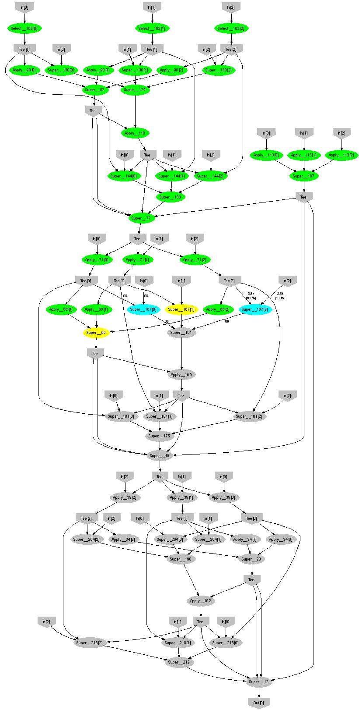
Expectation Maximization
160 lines
3 iterations shown
Notes:
More complicated, even iterative algorithms, can be implemented.

Slide 37
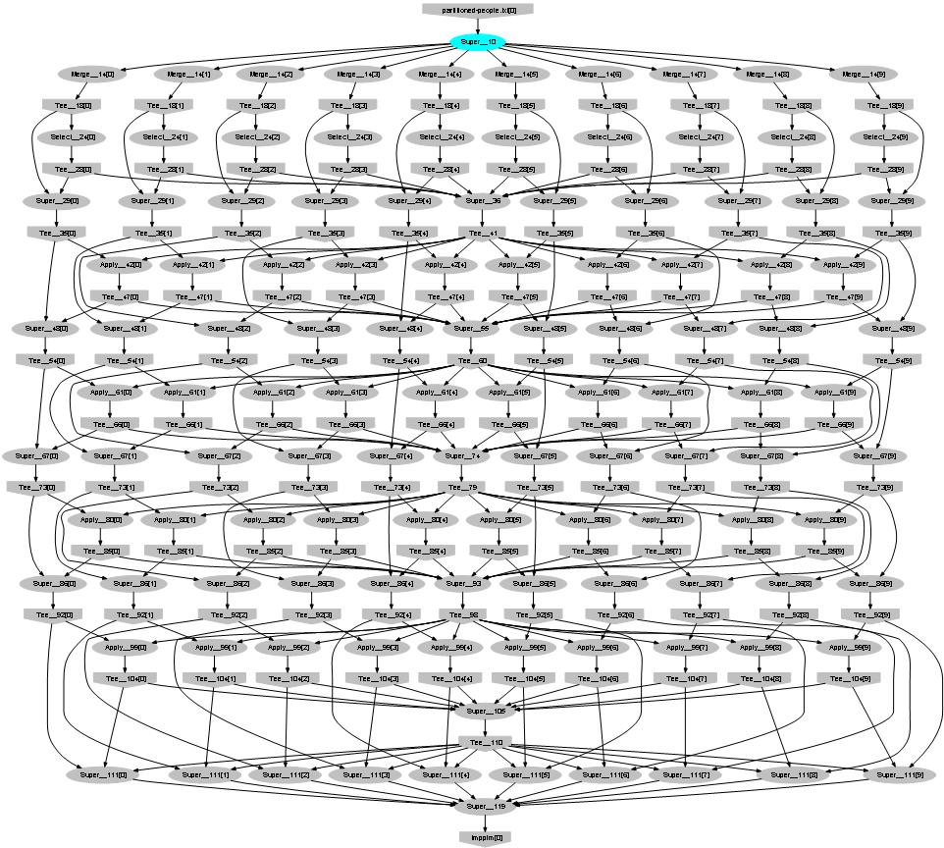
Probabilistic Index Maps
Images
features

Slide 38

Language Summary
Where
Select
GroupBy
OrderBy
Aggregate
Join
Apply
Materialize

Slide 39
LINQ System Architecture
Local machine
Execution engine
LINQ-to-obj
PLINQ
LINQ-to-SQL
LINQ-to-WS
DryadLINQ
Flickr
Oracle
LINQ-to-XML
Your own
.Net program
(C#, VB, F#, etc)
LINQ Provider
Query
Objects

Slide 40
The DryadLINQ Provider
Client machine
.Net
DryadLINQ
Data center
Distributed query plan
Query Expr
Invoke
Query
Vertex code
Con- text
Input Tables
ToCollection
Dryad JM
Dryad Execution
.Net Objects
Output DryadTable
Results
foreach
(11)
Output Tables

Slide 41
Combining Query Providers
Local machine
Execution engines
.Net program
(C#, VB, F#, etc)
LINQ Provider
PLINQ
Query
LINQ Provider
SQL Server
LINQ Provider
DryadLINQ
Objects
LINQ Provider
LINQ-to-obj

Slide 42
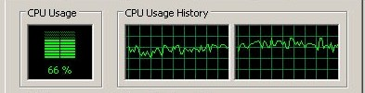
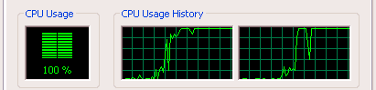
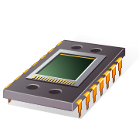
Using PLINQ
Query
DryadLINQ
Local query
PLINQ
Notes:
At the bottom DryadLINQ uses LINQ to run the computation in parallel on multiple cores.

Slide 43

Using LINQ to SQL Server
Query
DryadLINQ
Query
Query
Query
LINQ to SQL
LINQ to SQL
Query
Query

Slide 44
Using LINQ-to-objects
Local machine
LINQ to obj
debug
Query
production
DryadLINQ
Cluster

Slide 45
Outline
Introduction
Dryad
DryadLINQ
Building on/for DryadLINQ
System monitoring with Artemis
Privacy-preserving query language (PINQ)
Machine learning
Conclusions

Slide 46
Artemis: measuring clusters
Visualization
Plug-ins
Statistics
Job
browser
Cluster
browser/
manager
Log collection
DryadLINQ
DB
Cluster/Job State API
Cosmos Cluster
HPC
Cluster
Azure
Cluster

Slide 47
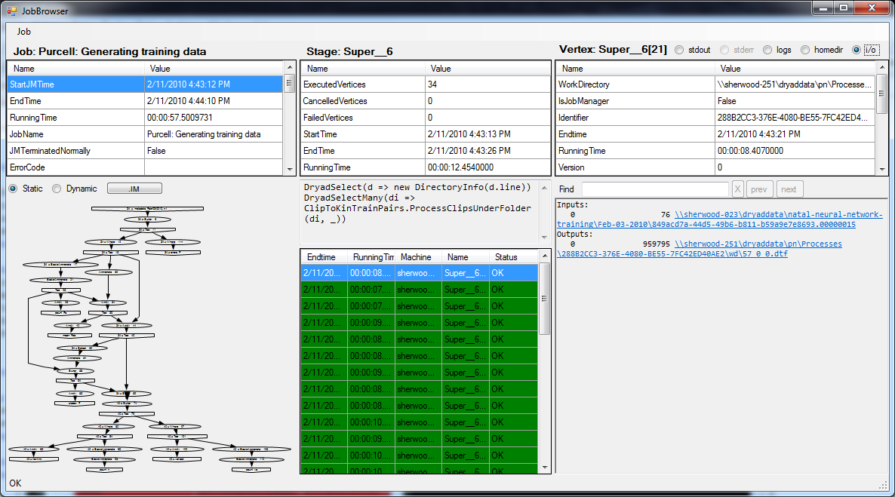
DryadLINQ job browser

Slide 48
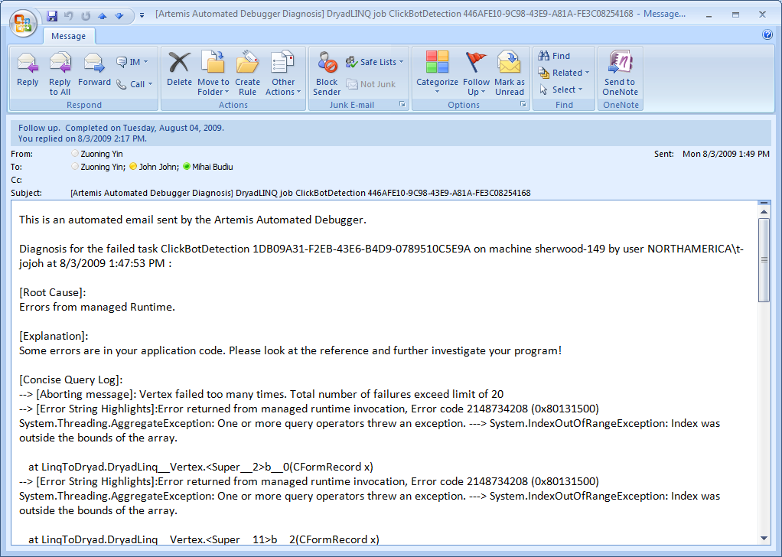
Automated diagnostics

Slide 49
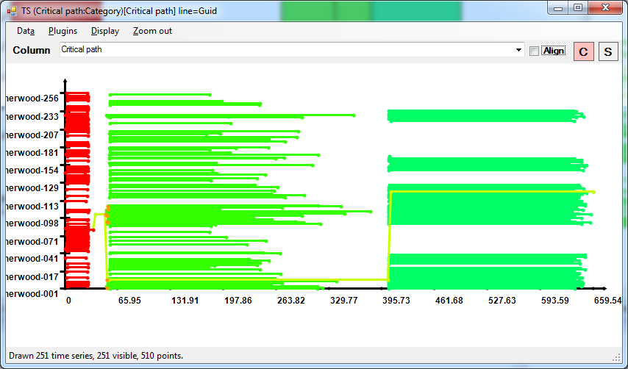
Job statistics: schedule and critical path

Slide 50
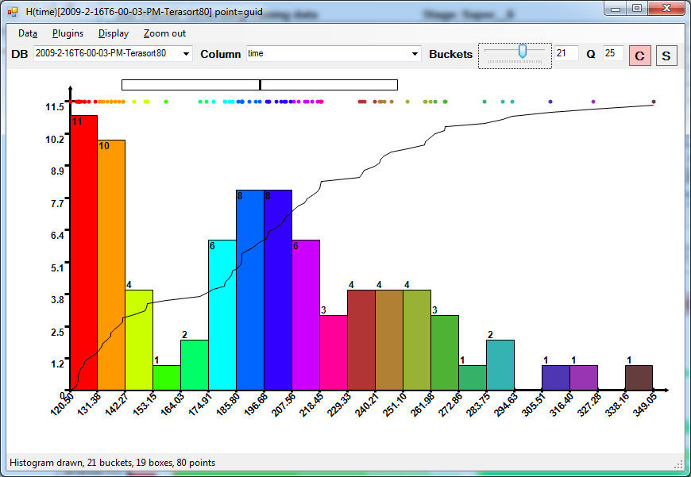
Running time distribution

Slide 51
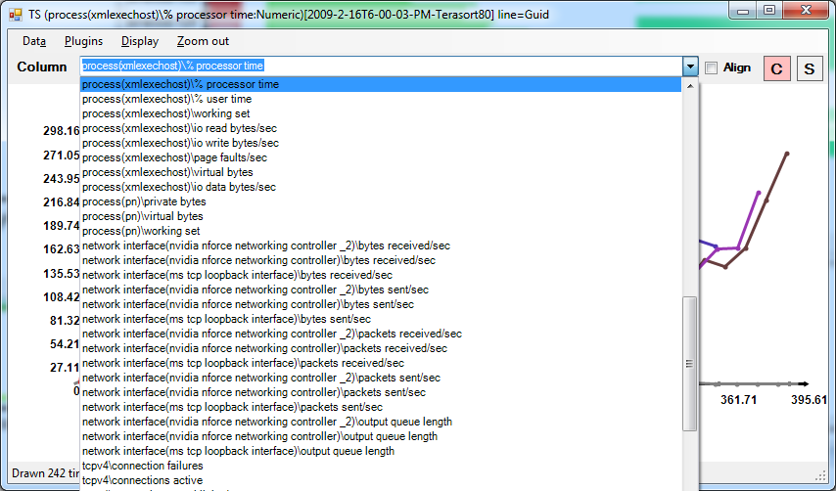
Performance counters

Slide 52
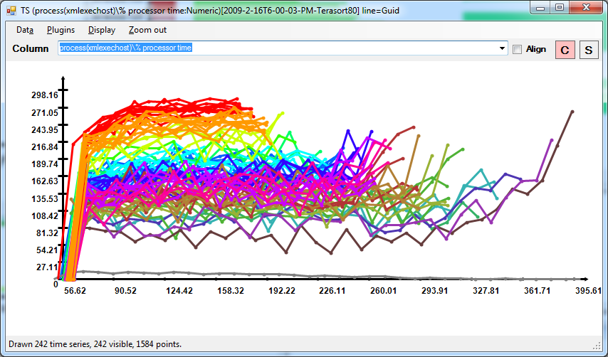
CPU Utilization

Slide 53
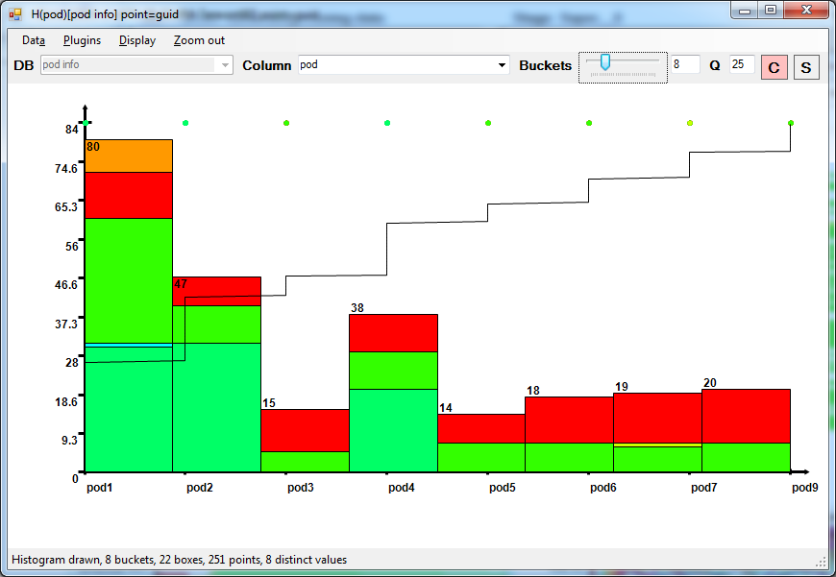
Load imbalance: rack assignment

Slide 54
PINQ
Queries
(LINQ)
Privacy-sensitive database
Answer

Slide 55
PINQ = Privacy-Preserving LINQ
“Type-safety” for privacy
Provides interface to data that looks very much like LINQ.
All access through the interface gives differential privacy.
Analysts write arbitrary C# code against data sets, like in LINQ.
No privacy expertise needed to produce analyses.
Privacy currency is used to limit per-record information released.

Slide 56
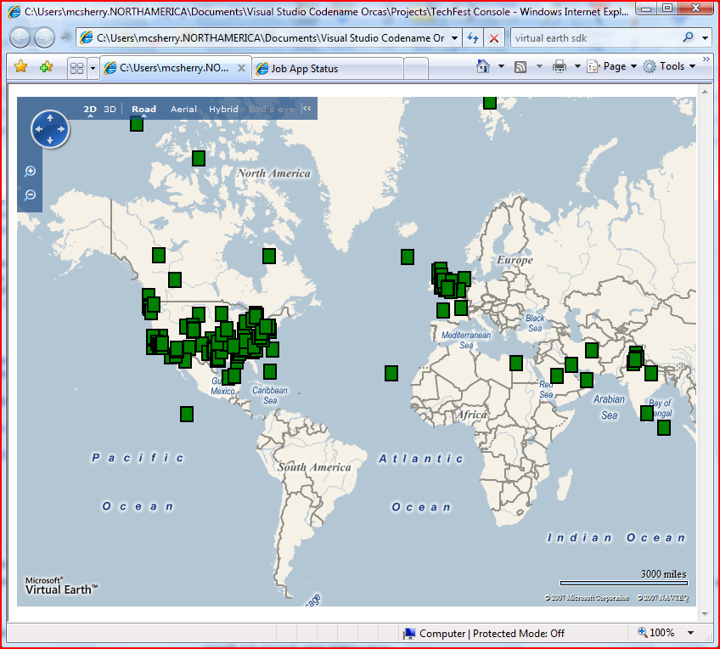
Example: search logs mining
// Open sensitive data set with state-of-the-art security
PINQueryable<VisitRecord> visits = OpenSecretData(password);
// Group visits by patient and identify frequent patients.
var patients = visits.GroupBy(x => x.Patient.SSN)
.Where(x => x.Count() > 5);
// Map each patient to their post code using their SSN.
var locations = patients.Join(SSNtoPost, x => x.SSN, y => y.SSN,
(x,y) => y.PostCode);
// Count post codes containing at least 10 frequent patients.
var activity = locations.GroupBy(x => x)
.Where(x => x.Count() > 10);
Visualize(activity); // Who knows what this does???
Distribution of queries about “Cricket”

Slide 57
PINQ Download
Implemented on top of DryadLINQ
Allows mining very sensitive datasets privately
Code is available
http://research.microsoft.com/en-us/projects/PINQ/
Frank McSherry, Privacy Integrated Queries, SIGMOD 2009

Slide 58


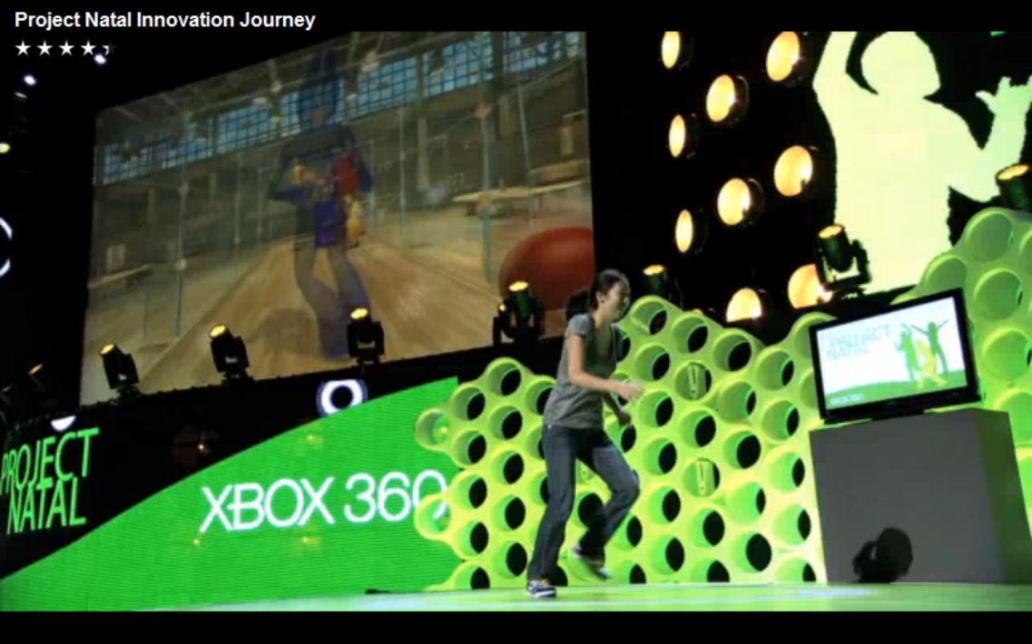
Natal Training

Slide 59


Natal Problem
Recognize players from depth map
At frame rate
Minimal resource usage
Notes:
Image from http://r24085.ovh.net/images/Gallery/depthMap-small.jpg

Slide 60



Learn from Data
Rasterize
Motion Capture
(ground truth)
Training examples
Machine learning
Classifier

Slide 61
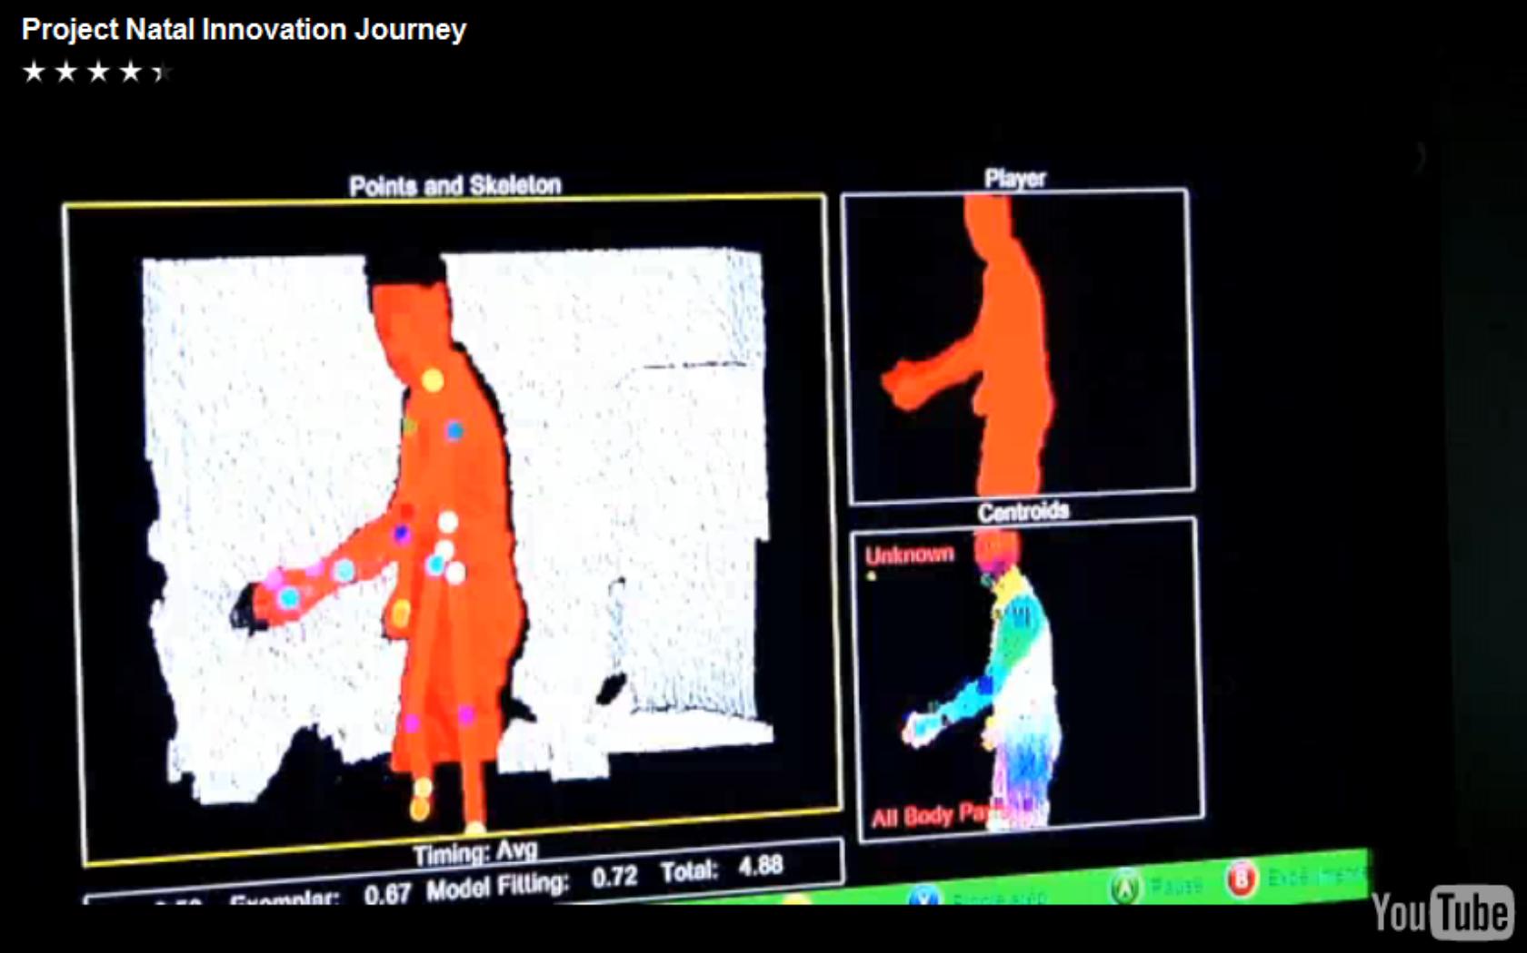
Running on Xbox

Slide 62
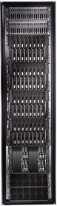
Learning from data
Classifier
Training examples
Machine learning
DryadLINQ
Dryad

Slide 63
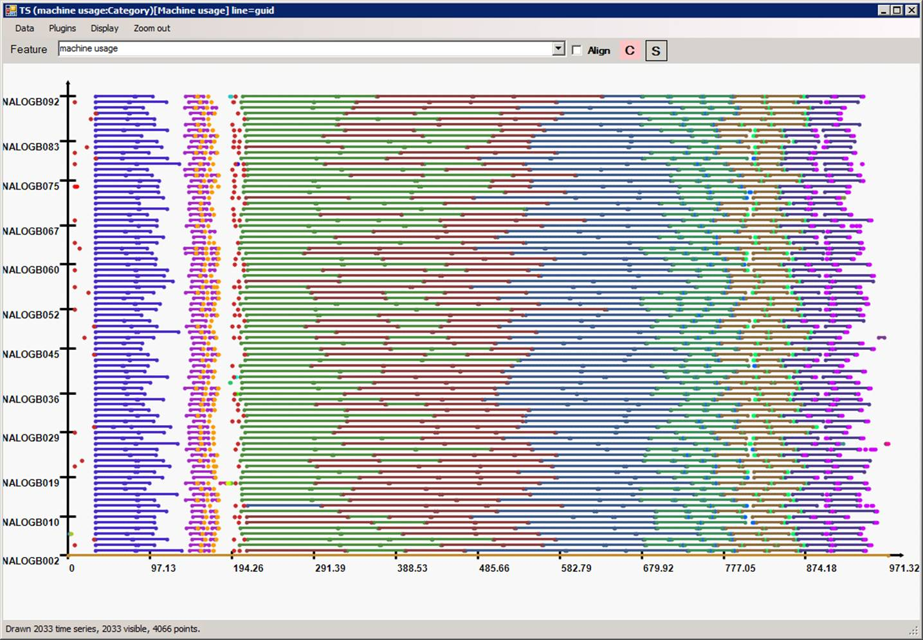
Highly efficient parallellization

Slide 64
Outline
Introduction
Dryad
DryadLINQ
Building on DryadLINQ
Conclusions

Slide 65

Lessons Learned
Complete separation of storage / execution / language
Using LINQ +.Net (language integration)
Static typing
No protocol buffers (serialization code)
Allowing flexible and powerful policies
Centralized job manager: no replication, no consensus, no checkpointing
Porting (HPC, Cosmos, Azure, SQL Server)

Slide 66
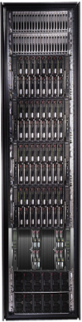
Conclusions
Visual Studio
LINQ
Dryad
=
66
Notes:
We believe that Dryad and DryadLINQ are a great foundation for cluster computing.

Slide 67
“What’s the point if I can’t have it?”
Dryad+DryadLINQ available for download
Academic license
Commercial evaluation license
Runs on Windows HPC platform
Dryad is in binary form, DryadLINQ in source
Requires signing a 3-page licensing agreement
http://connect.microsoft.com/site/sitehome.aspx?SiteID=891

Slide 68

Backup Slides

Slide 69
What does DryadLINQ do?
public struct Data { …
public static int Compare(Data left, Data right);
}
Data g = new Data();
var result = table.Where(s => Data.Compare(s, g) < 0);
public static void Read(this DryadBinaryReader reader, out Data obj);
public static int Write(this DryadBinaryWriter writer, Data obj);
public class DryadFactoryType__0 : LinqToDryad.DryadFactory<Data>
Data serialization
Data factory
DryadVertexEnv denv = new DryadVertexEnv(args);
var dwriter__2 = denv.MakeWriter(FactoryType__0);
var dreader__3 = denv.MakeReader(FactoryType__0);
var source__4 = DryadLinqVertex.Where(dreader__3,
s => (Data.Compare(s, ((Data)DryadLinqObjectStore.Get(0))) < ((System.Int32)(0))), false);
dwriter__2.WriteItemSequence(source__4);
Channel writer
Channel reader
LINQ code
Context serialization

Slide 70
Ongoing Dryad/DryadLINQ Research
Performance modeling
Scheduling and resource allocation
Profiling and performance debugging
Incremental computation
Hardware acceleration
High-level programming abstractions
Many domain-specific applications

Slide 71
Sample applications written using DryadLINQ | Class
Distributed linear algebra | Numerical
Accelerated Page-Rank computation | Web graph
Privacy-preserving query language | Data mining
Expectation maximization for a mixture of Gaussians | Clustering
K-means | Clustering
Linear regression | Statistics
Probabilistic Index Maps | Image processing
Principal component analysis | Data mining
Probabilistic Latent Semantic Indexing | Data mining
Performance analysis and visualization | Debugging
Road network shortest-path preprocessing | Graph
Botnet detection | Data mining
Epitome computation | Image processing
Neural network training | Statistics
Parallel machine learning framework infer.net | Machine learning
Distributed query caching | Optimization
Image indexing | Image processing
Web indexing structure | Web graph

Slide 72

Staging
1. Build
2. Send .exe
7. Serialize vertices
vertex code
5. Generate graph
JM code
Cluster services
6. Initialize vertices
3. Start JM
8. Monitor
Vertex execution
4. Query cluster resources
Notes:
Computation Staging

Slide 73
Bibliography
Dryad: Distributed Data-Parallel Programs from Sequential Building Blocks
Michael Isard, Mihai Budiu, Yuan Yu, Andrew Birrell, and Dennis Fetterly
European Conference on Computer Systems (EuroSys), Lisbon, Portugal, March 21-23, 2007
DryadLINQ: A System for General-Purpose Distributed Data-Parallel Computing Using a High-Level Language
Yuan Yu, Michael Isard, Dennis Fetterly, Mihai Budiu, Úlfar Erlingsson, Pradeep Kumar Gunda, and Jon Currey Symposium on Operating System Design and Implementation (OSDI), San Diego, CA, December 8-10, 2008
SCOPE: Easy and Efficient Parallel Processing of Massive Data Sets Ronnie Chaiken, Bob Jenkins, Per-Åke Larson, Bill Ramsey, Darren Shakib, Simon Weaver, and Jingren Zhou
Very Large Databases Conference (VLDB), Auckland, New Zealand, August 23-28 2008
Hunting for problems with Artemis Gabriela F. Creţu-Ciocârlie, Mihai Budiu, and Moises Goldszmidt USENIX Workshop on the Analysis of System Logs (WASL), San Diego, CA, December 7, 2008
DryadInc: Reusing work in large-scale computations Lucian Popa, Mihai Budiu, Yuan Yu, and Michael Isard Workshop on Hot Topics in Cloud Computing (HotCloud), San Diego, CA, June 15, 2009
Distributed Aggregation for Data-Parallel Computing: Interfaces and Implementations,
Yuan Yu, Pradeep Kumar Gunda, and Michael Isard,
ACM Symposium on Operating Systems Principles (SOSP), October 2009
Quincy: Fair Scheduling for Distributed Computing Clusters
Michael Isard, Vijayan Prabhakaran, Jon Currey, Udi Wieder, Kunal Talwar, and Andrew Goldberg ACM Symposium on Operating Systems Principles (SOSP), October 2009

Slide 74
Incremental Computation
…
Outputs
Distributed
Computation
…
Inputs
Append-only data
Goal: Reuse (part of) prior computations to:
Speed up the current job
Increase cluster throughput
Reduce energy and costs

Slide 75
Propose Two Approaches
1. Reuse Identical computations from the past
(like make or memoization)
2. Do only incremental computation on the new data
and Merge results with the previous ones
(like patch)

Slide 76
Context
Implemented for Dryad
Dryad Job = Computational DAG
Vertex: arbitrary computation + inputs/outputs
Edge: data flows
Simple Example:
Record Count
Outputs
Add
A
Count
C
C
Inputs
(partitions)
I1
I2

Slide 77
Identical Computation
Record Count
First execution DAG
Outputs
Add
A
Count
C
C
Inputs
(partitions)
I1
I2

Slide 78
Identical Computation
Record Count
Second execution DAG
Outputs
Add
A
Count
C
C
C
Inputs
(partitions)
I1
I2
I3
New Input

Slide 79
IDE – IDEntical Computation
Record Count
Second execution DAG
Outputs
Add
A
Count
C
C
C
Inputs
(partitions)
I1
I2
I3
Identical subDAG

Slide 80
Identical Computation
Replace identical computational subDAG with
edge data cached from previous execution
IDE Modified DAG
Outputs
Add
A
Count
C
Inputs
(partitions)
Replaced with Cached Data
I3

Slide 81
Identical Computation
Replace identical computational subDAG with
edge data cached from previous execution
IDE Modified DAG
Outputs
Add
A
Count
C
Inputs
(partitions)
I3
Use DAG fingerprints to determine if computations are identical

Slide 82
Semantic Knowledge Can Help
Reuse Output
A
C
C
I1
I2

Slide 83
Semantic Knowledge Can Help
Previous Output
A
Merge (Add)
A
C
I3
C
C
I1
I2
Incremental DAG

Slide 84
Mergeable Computation
User-specified
A
Merge (Add)
Automatically Inferred
A
C
I3
C
C
I1
I2
Automatically Built

Slide 85
Mergeable Computation
Merge Vertex
Save to Cache
A
Incremental DAG – Remove Old Inputs
A
A
C
C
C
C
C
I1
Empty
I2
I1
I2
I3

